Slide 1

8
Chapter
Organizational Structure and Design
© Pearson Education Limited 2015
6-<number>

Slide 2
Learning Outcomes
Describe six key elements in organizational design.
Identify the contingency factors that favor either the mechanistic model or the organic model of organizational design.
Compare and contrast traditional and contemporary organizational designs.
Discuss the design challenges faced by today’s organizations.
© Pearson Education Limited 2015
6-<number>
Notes:
After studying this chapter, you will be able to:
Describe six key elements in organizational design.
Identify the contingency factors that favor either the mechanistic model or the organic model of organizational design.
Compare and contrast traditional and contemporary organizational designs.
Discuss the design challenges faced by today’s organizations.

Slide 3
8.1
Describe six key elements in organizational design.
© Pearson Education Limited 2015
6-<number>

Slide 4
Organizing is the management function that creates the organization’s structure. When managers develop or change the organization’s structure, they’re engaging in organization design, which is the process of making decisions about how specialized jobs should be, the rules to guide employees’ behaviors, and the level at which decisions will be made.
© Pearson Education Limited 2015
1-<number>

Slide 5
Elements of Organizational Structure
  Work specialization
  Departmentalization
  Authority and responsibility
  Span of control
  Centralization vs. decentralization
  Formalization
© Pearson Education Limited 2015
6-<number>

Slide 6
Work specialization is the division of work activities into separate job tasks.
EX: At the Wilson Sporting Goods factory in Ada, Ohio, workers making NFL footballs specialize in job tasks—such as molding, stitching and sewing, and lacing—to increase work output.
© Pearson Education Limited 2015
1-<number>

Slide 7
When first introduced, specialization almost always generated higher productivity.
But at some point, the human diseconomies—boredom, fatigue, stress, low productivity, poor quality, increased absenteeism, and high turnover—exceed the economic advantages
© Pearson Education Limited 2015
1-<number>

Slide 8
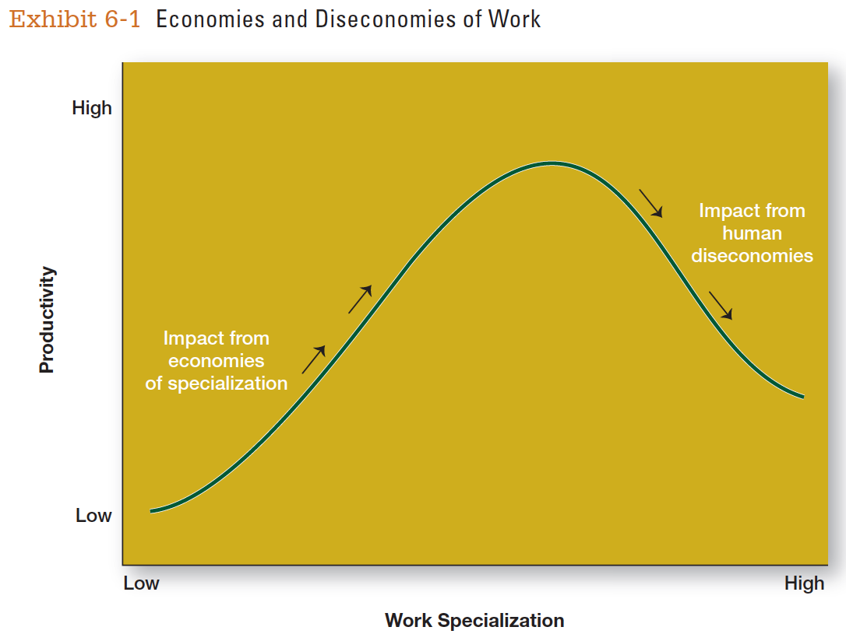
Specialization
© Pearson Education Limited 2015
6-<number>
Notes:
Most managers today see work specialization as an important organizing mechanism because it helps employees to be more efficient. However, managers also have to recognize its limitations.

Slide 9
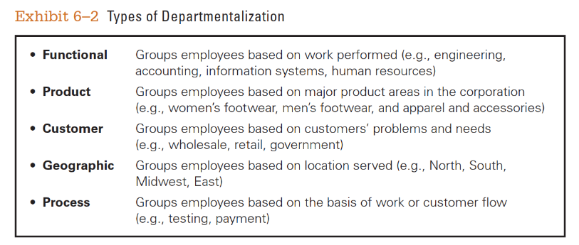
Departmentalization
© Pearson Education Limited 2015
6-<number>

Slide 10
Types of Authority Relationships
When organizing work, managers need to clarify who reports to whom, which is know as the chain of command—that is, the line of authority extending from upper to lower organizational levels.
© Pearson Education Limited 2015
1-<number>

Slide 11
Authority refers to the rights inherent in a managerial position to give orders and expect the orders to be obeyed.
© Pearson Education Limited 2015
1-<number>

Slide 12
When managers delegate authority, they must allocate responsibility.
That is, when employees are given rights they also assume a corresponding obligation to perform and be held accountable for their performance.
© Pearson Education Limited 2015
1-<number>

Slide 13
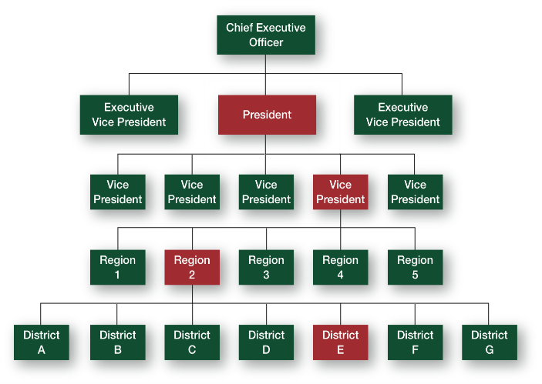
Types of Authority Relationships
© Pearson Education Limited 2015
6-<number>
Notes:
Early management writers distinguished between two forms of authority: line authority and staff authority. Line authority entitles a manager to direct the work of an employee according to the chain of command, which is shown here in Exhibit 6-3. In the chain of command, every manager is subject to the direction of his or her superior.
Sometimes the term ”line” is used to differentiate line managers from staff managers. In this context, line refers to managers whose organizational function contributes directly to the achievement of organizational objectives.
Whether a manager’s function is classified as line or staff depends on the organization’s objectives.

Slide 14
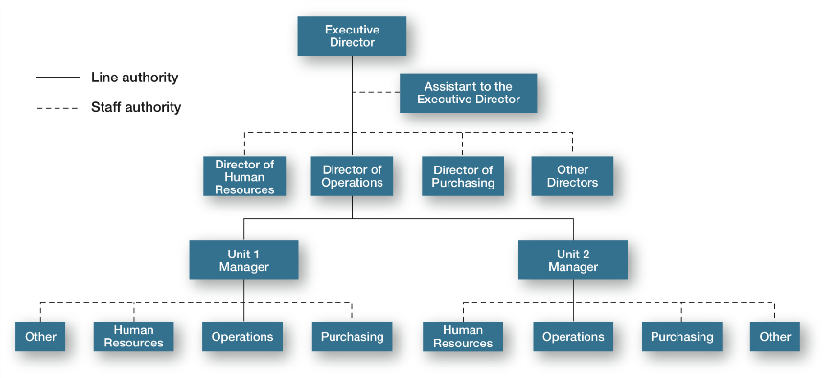
Line and Staff Authority
© Pearson Education Limited 2015
6-<number>
Notes:
As organizations get larger and more complex, line managers find that they do not have the time, expertise, or resources to get their jobs done effectively. In response, they create staff authority functions to support, assist, advise, and generally reduce some of their informational burdens.

Slide 15
Unity of Command
A structure in which each employee reports to only one manager.
© Pearson Education Limited 2015
6-<number>

Slide 16
How Do Authority and Power Differ?
Authority:
a right whose legitimacy is based on an authority figure’s position in the organization; it goes with the job
Power:
an individual’s ability to influence decisions
© Pearson Education Limited 2015
6-<number>
Notes:
Authority and power are often considered the same thing, but they’re not. Authority is a right and its legitimacy is based on an authority figure’s position in the organization. Power, on the other hand, refers to an individual’s capacity to influence decisions.

Slide 17
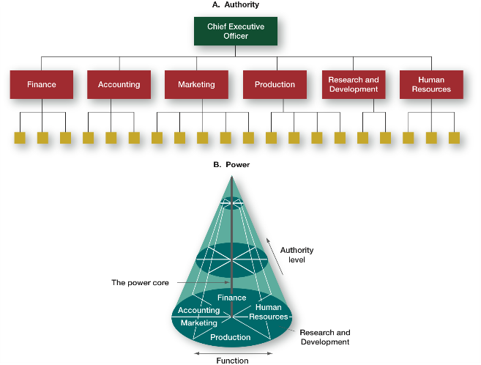
Power Versus Authority
© Pearson Education Limited 2015
6-<number>

Slide 18
Span of Control
How many employees a manager efficiently and effectively can supervise?
© Pearson Education Limited 2015
1-<number>

Slide 19
Span of Control
Most effective and efficient span depends on:
Employee experience and training (more they have, larger span, less direct supervision they need).
Similarity of employee tasks (more similarity, larger span).
Complexity of those tasks (more complex, smaller span).
the manager’s preferred managing style.
© Pearson Education Limited 2015
6-<number>

Slide 20
Centralization & Decentralization
When organizing, managers need to ask, “At what level are decisions made?”
© Pearson Education Limited 2015
1-<number>

Slide 21
Centralization & Decentralization
Centralization
decision making takes place at upper levels of the organization
Decentralization
lower-level managers provide input or actually make decisions
© Pearson Education Limited 2015
6-<number>

Slide 22
Formalization
How standardized an organization’s jobs are and the extent to which employee behavior is guided by rules and procedures.
In highly formalized organizations, (bureaucratic –style organizations) there are explicit job descriptions, numerous organizational rules, and clearly defined procedures covering work processes.
© Pearson Education Limited 2015
6-<number>

Slide 23
8.2
Identify the contingency factors that favor either the mechanistic model or the organic model of organizational design.
© Pearson Education Limited 2015
6-<number>

Slide 24
Models of Organizational Design
The mechanistic organization (or bureaucracy) that combines traditional aspects of all six elements of organization structure.
  high specialization
  rigid departmentalization
  clear chain of command
  narrow spans of control leading to taller structure
  centralization
  high formalization
1-<number>

Slide 25
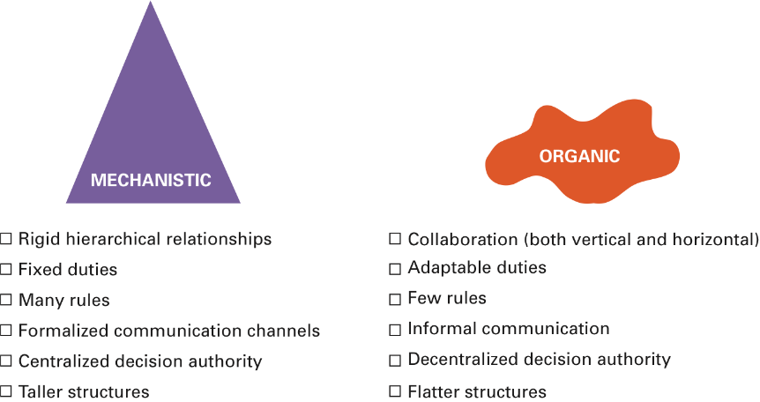
Models of Organizational Design
© Pearson Education Limited 2015
6-<number>

Slide 26
Strategy and Structure
Certain structural designs work best with different organizational strategies.
Passionate of innovation is associated with an organic structure,
while a passionate of cost control is associated with a mechanistic organization.
© Pearson Education Limited 2015
6-<number>

Slide 27
Size and Structure
Organic
Less than 2,000 employees can be organic.
Mechanistic
More than 2,000 employees makes forces organizations to become more mechanistic.
© Pearson Education Limited 2015
6-<number>

Slide 28
Technology and Structure
More routine technology; more likely to have mechanistic structure
More nonroutine technology; more likely to have organic structure
© Pearson Education Limited 2015
1-<number>

Slide 29
Environment and Structure
Stable environment: mechanistic structure
Dynamic environment/uncertain environment: organic structure (fast and flexible)
© Pearson Education Limited 2015
6-<number>

Slide 30
8.3
Compare and contrast traditional and contemporary organizational designs.
© Pearson Education Limited 2015
6-<number>

Slide 31
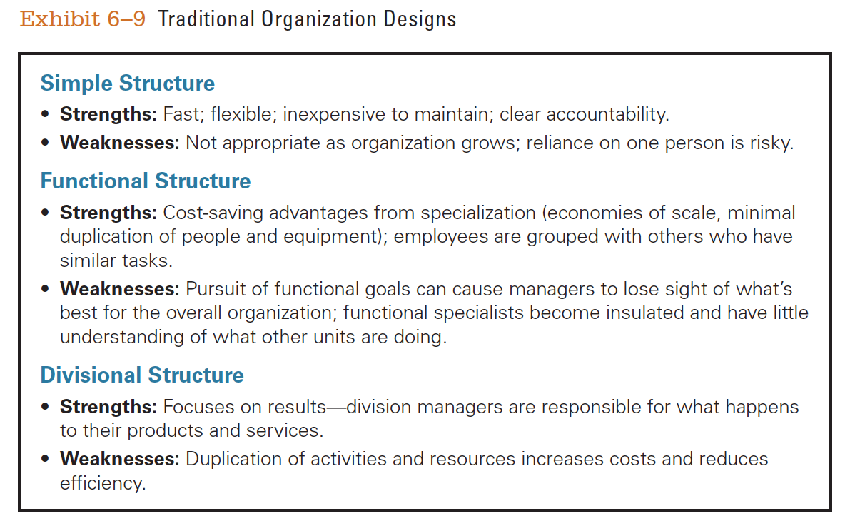
Traditional Organizational Designs
© Pearson Education Limited 2015
6-<number>

Slide 32
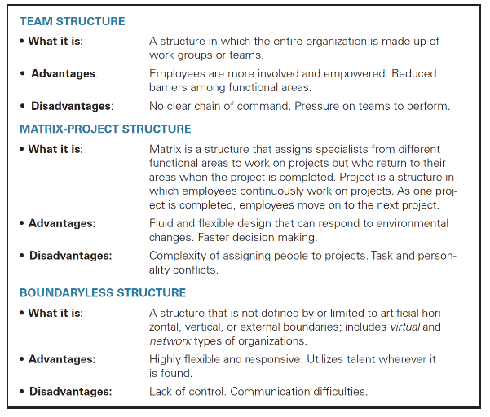
Contemporary Organizational Design
© Pearson Education Limited 2015
6-<number>

Slide 33
Team Structure
A structure in which the entire organization is made up of work teams that do the organization’s work.
© Pearson Education Limited 2015
6-<number>

Slide 34
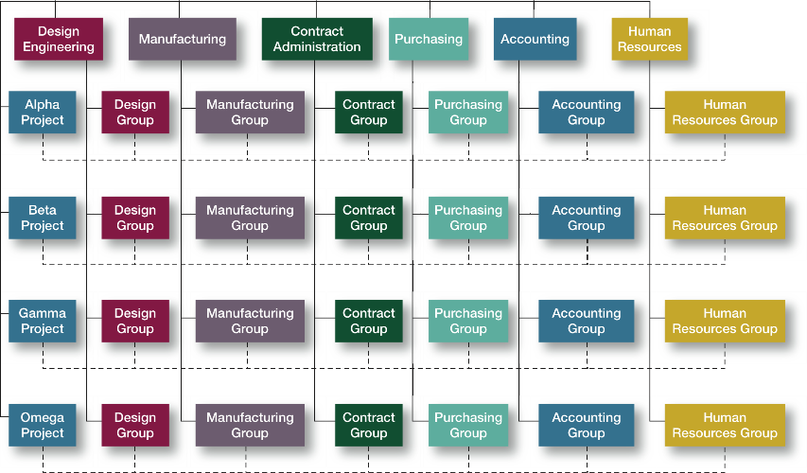
Matrix and Project Structures
© Pearson Education Limited 2015
6-<number>

Slide 35
Project Structure
A structure in which employees continuously work on projects.
© Pearson Education Limited 2015
6-<number>

Slide 36
Boundaryless Organizations
An organization whose design is not imposed by a predefined structure.
© Pearson Education Limited 2015
6-<number>

